Slide 1
School Nutrition and Academic Achievement
Insert Your Name Here
Notes:
Slide 1
Suggested Talking Points:
Hello, my name is _________________________.
I attend / My child attends / I work at (name of school).
I am a (student / parent / teacher / staff member / concerned community member).
I am here because the Local Control Funding Formula gives us an incredible opportunity to invest in the health and academic success of our children. I am asking you to increase support for our school nutrition programs so that our students have the fuel they need to succeed inside and outside of the classroom.

Slide 2
“
YOU CAN’T SLEEP
ITS HARD TO PAY ATTENTION IN CLASS
AND IT FEELS LIKE THERE’S A DARK CLOUD OVER YOU, THAT NO ONE CARES.
”
Notes:
Slide 2
Start with a quote or story that conveys the connection between nutrition
and academic achievement. The above quote is an example from a student at Oakland Unified School District. You can read his story here: http://bit.ly/2gvLobs.
Suggested Talking Points:
For some of our students, meals served at school may be the only nutritious meal they receive all day.
We know through research that students who are hungry are more likely to be suspended from school, repeat a grade, and not get along with their peers. Our school nutrition programs can help provide our students with the nutrition they need to fully focus in the classroom.
Not all of eligible students in our school district participate in our free and reduced-price meal programs. We can reach more students with healthy meals if our school district increased support for our school nutrition programs.

Slide 3

Notes:
Slide 3
Suggested Talking Points:
Supporting efforts to increase access to nutritious meals and quality drinking water is a smart investment for our school district. When we invest in our school nutrition programs, low-income students directly benefit.
A strategic investment of Local Control Funding Formula funds into our school nutrition programs can improve nutrition access while simultaneously helping us achieve many of the state priorities that must be addressed in our Local Control and Accountability Plan. School nutrition is connected to each of the state priority areas.

Slide 4

Student achievement
School climate
Student engagement
Parental involvement
Common Core standards
Broad course of study
Pupil outcomes
Basic services
Notes:
Slide 4
Suggested Talking Points:
Our school nutrition programs support student achievement. Participation in the school nutrition programs has been linked through research to improved test scores and other markers of improved academic and cognitive performance including performance on the Academic Performance Index, GPA, standardized test scores, math scores, and literacy. Water intake has also been shown to improve students’ classroom focus.
If students attend class thirsty or hungry they are more likely to exhibit behavioral problems which not only detract from their own school experience, but the experiences of their classmates. Our school nutrition programs are an integral part of the school day. An investment in our school nutrition programs can improve the school climate for all students, allowing children and teachers to focus on lessons with fewer disruptions.

Slide 5

Student achievement
School climate
Student engagement
Parental involvement
Common Core standards
Broad course of study
Pupil outcomes
Basic Services
Notes:
Slide 5
Suggested Talking Points:
Our school nutrition programs have the ability to address some of the root causes that prevent students from coming to school regularly. By keeping children healthy and well nourished school nutrition programs help our students stay in school and contribute to reducing absenteeism. Students are more likely to attend school when they enjoy their overall school experience.
Parents also care about the health and well being of their children. We can engage parents and students as contributors to our school nutrition environment by encouraging their participation on our student wellness policy council and seeking their input on improving our school nutrition programs.

Slide 6

Student achievement
School climate
Student engagement
Parental involvement
Common Core standards
Broad course of study
Pupil outcomes
Basic services
Notes:
Slide 6
Suggested Talking Points:
Our school district is required to report within our LCAP how we will support implementation of academic content and performance standards adopted by the state board. We are required to report how we will ensure students are enrolled in a broad course of study.
Providing course content on nutrition and wellness will expand the breadth of courses our students have access to. Whether in the garden, the cafeteria, or in the classroom nutrition and health education can be incorporated into project­ based learning activities aligned with state adopted academic content and performance standards. Nutrition and health education can be used to support Common Core Standards, Next Generation Science Standards and more.

Slide 7

Student achievement
School climate
Student engagement
Parental involvement
Common Core standards
Broad course of study
Pupil outcomes
Basic services
Notes:
Slide 7
Suggested Talking Points:
Providing students with safe and convenient places to eat supports their academic success. School districts are required in the LCAP to ensure school facilities are in 'good repair.’ This includes safe and convenient access to drinking water. By investing in water access and in our school cafeterias we not only can ensure that students have a safe and convenient place to eat and drink, but we also will contribute to their overall school experience, and encourage students to access the health and academic benefits of drinking water and participating in our school nutrition programs.

Slide 8
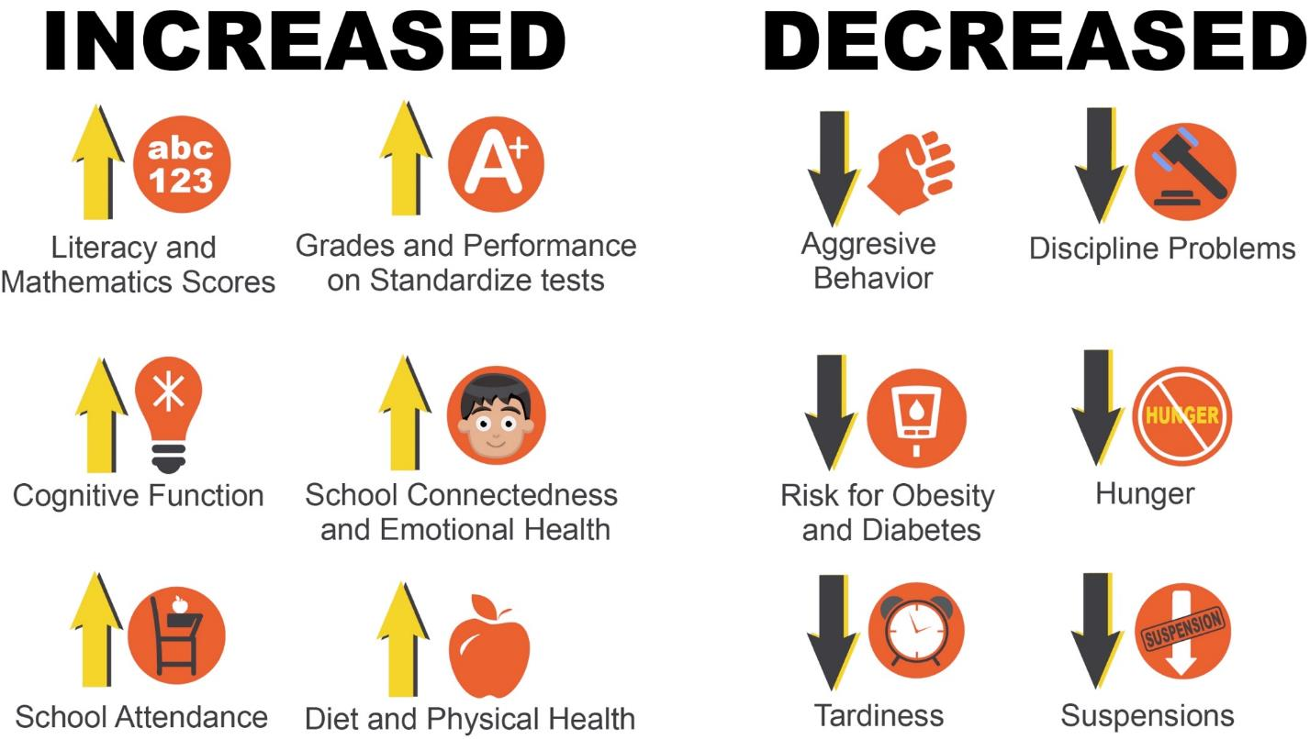
Notes:
Slide 8
Suggested Talking Points:
In summary, a strategic investment of Local Control Funding Formula funds into our school nutrition programs can improve nutrition access while simultaneously helping us achieve many of the state priorities that must be addressed in our Local Control and Accountability Plan.
I have provided you with a research summary which shares how our school nutrition programs improve: cognitive function, diet and physical health, school connectedness, emotional health, literacy and mathematics scores, school attendance, grades, and academic performance on standardized tests. In it you will also find links to research on how our school nutrition programs reduce hunger, decrease aggressive behavior, discipline problems, risk for obesity and diabetes, tardiness, and suspensions.
I have also shared a number of examples of how other school districts across our state have incorporated school nutrition programs into their Local Control and Accountability Plans.

Slide 9

Thank You!
Please Support:
[insert your top priorities here]
Notes:
Slide 9
Suggested Talking Points:
Lets join the other school districts that have prioritized their student’s wellness needs. I am asking you to take a step back and think about what our students truly need to succeed. My request to the school board is to allocate funding and to make a commitment in our Local Control and Accountability Plan to support our school nutrition programs. There are many things we can do, but I am asking you to: ________________________________________________________________________________________________________________________________________________________________________________________________________________________________________________________________________________________________________________________________________________________________________________________________________________.
Thank you so much for your time and for considering this important request. Please let me know if I can be of assistance with moving forward on this request.

