Slide 1
Policy Opportunities: Safe Spaces at Summer Meal Sites and Beyond
Anna Colby, MS, MPP
Nutrition Policy Advocate
California Food Policy Advocates

Slide 2
Notes:
While these stats aren’t specific to immigrant children, we know that immigrant families may face additional risks– they may be eligible for fewer public benefits or may be hesitant to access public benefits, especially given our current political climate.
We also know that when a parent is deported, children left behind may be living in households with dramatically reduced incomes.
Many of these children rely on school meals during the school year. Some students eat three meals a day at school
There’s a lot at stake when schools let our for the summer.

Slide 3
Notes:
Luckily, there are summer meal programs that provide free and reduced price meals to students across our state.
These meals support student health, well-being and academic success.
For more information on summer hunger in California: http://cfpa.net/sowa-2017

Slide 4
Yet during summer 2016…
Notes:
*These are children that benefited from free and reduced-price lunches during the school year but miss out on similar meals during the summer.
Data Source: CFPA’s analysis of NSLP (public, non-charter school), SFSP, and SSFO data of free or reduced price meals served in July 2016 provided by the California Department of Education. See technical appendix for details.
Sponsors and sites, community-based partners, the CDE and others are working hard to provide summer meals to children across our state. However, there are a lot of barriers to accessing free or low-cost summer meals, such as lack of transportation, extreme weather conditions, lack of walkable routes, etc. There are challenges with outreach– many families don’t know when and where meals are provided during the summer.
Our immigrant families face these barriers to accessing summer meals plus the additional barriers that come along with fear of immigration enforcement that may lead to families being more hesitant to leave the house, or pulling back from accessing public benefits for which that they or their children may be eligible. Challenges are magnified for some of our most vulnerable children.

Slide 5
Policy Matters.
Policy actions can make summer meals more accessible, welcoming, and safer for immigrant families
Notes:
Policy actions have the potential to make a big impact across our state.
While immigration policy is set at the federal level, there is a lot that our state can do to improve access to summer meals (address barriers and challenges) and foster safe and welcoming spaces for immigrant families
We can’t guarantee 100% safety but we can take steps to provide additional protection to our immigrant families
Our state is already taking some actions to provide certain safeguards to immigrants in select public places such as schools, such as AB 699 (O’Donnell) and SB 54 (De León). Note that these legislations do not currently address safety for summer sites, specifically.
CFPA recommends exploring approaches similar to current state legislative efforts. Where can we extend and expand current policy efforts to increase safety and/or foster welcoming environments for immigrant families
While my recommendations are framed in terms of summer meals for this conversation, ultimately we have an eye for policy actions that could address barriers to immigrant families to accessing food more broadly.

Slide 6
Policy action that would…
prohibit immigration enforcement activities at summer meal sites
Notes:
Can we expand upon current state policy efforts to prohibit…
Immigration and Customs Enforcement (ICE) from entering summer meal locations while participants are present
Law enforcement, school police or security departments from engaging in immigration enforcement activities during summer meal times

Slide 7
Policy action that would…
restrict the collection and sharing of participant information
Notes:
Summer meal sites that are open to the community are not required registration or the collection of any information. A policy could go one step further to ensure that summer meal programs are prohibited from:
The collection of information about the immigration status of summer meal participants or their families
Sponsors or sites from providing any information, or access to any databases, about participants for the purpose of immigration enforcement

Slide 8
Policy action that would…
support outreach efforts to families and training for site staff
Notes:
Can we expand upon current state program and policy efforts and compel…
School districts to provide information to parents before the end of the school year about summer meals and the rights of children to receive meals regardless of immigration status
Outreach to be conducted in the language that students and families speak at home
Summer meal staff to be trained on how best to support immigrant families. Trainings could include immigrant rights, preventing bullying based on immigration status, or what to do if ICE shows up at a site or if a child becomes separated from their caregiver due to possible immigration enforcement actions.

Slide 9
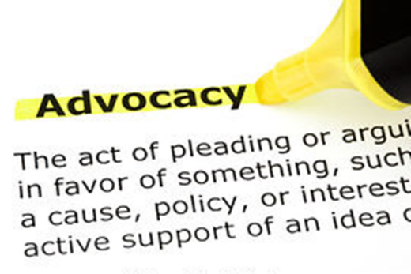
Be an Advocate for Change!
Subscribe to CFPA Action Alerts: cfpa.net/subscribe
Notes:
I commend all of you for taking this step of being on the call today. I encourage you to take concrete action based on the recommendations that you heard from my colleagues. I also encourage you to stay involved.
One of the ways that CFPA “speaks up” is through policy action. Then, we ask that people like you “speak up” and voice your support for these actions. To stay involved please subscribe to CFPA’s Action Alerts: http://cfpa.net/subscribe

Slide 10
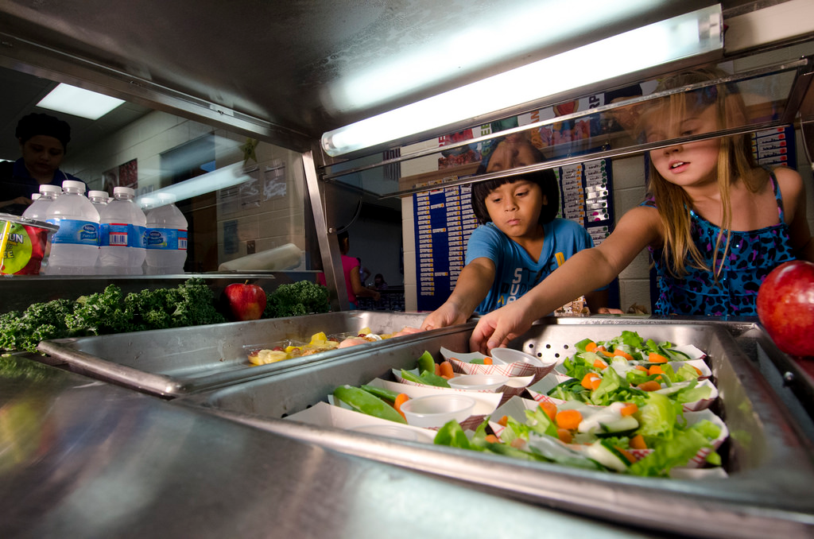
Thank you!
For more information about summer hunger in California:
cfpa.net/sowa-2017
Anna Colby, MS, MPP
Nutrition Policy Advocate
213.482.8200 x 204
anna@cfpa.net
Follow us on Twitter @CAFoodPolicy
Notes:
For more information about summer hunger in California: cfpa.net/sowa-2017

Slide 11
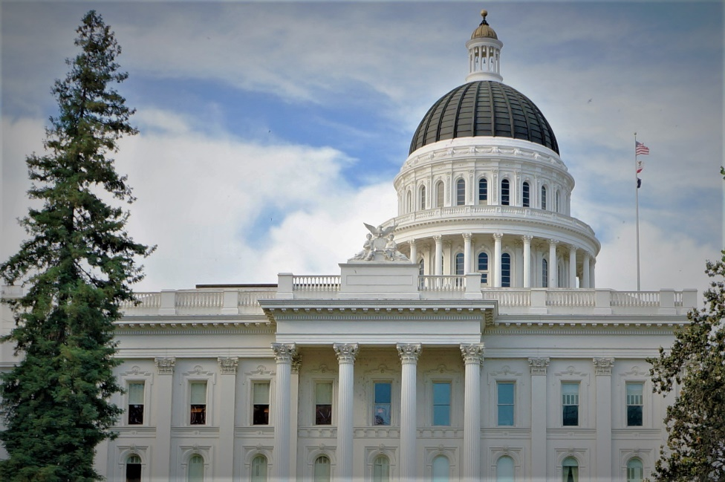
Current Legislative Efforts
AB 699 (O’Donnell): Educational equity: immigration status
SB 54 (De León): Law enforcement: sharing data
Learn more at leginfo.legislature.ca.gov

