Slide 1
A Discussion of Immigrants and Summer Foods Best Practices & Internal Policies
Betzabel Estudillo
California Immigrant Policy Center
June 26, 2017

Slide 2
Founded in 1996, CIPC is a non-partisan, non-profit statewide organization that seeks to inform public debate and policy decisions on issues affecting the state’s immigrants and their families in order to improve the quality of life for all Californians. CIPC engages in policy advocacy, and provides technical assistance, training and education on immigrant issues.

Slide 3
Anti-Immigrant Climate
These are difficult times for immigrant families
Trump signed Executive Orders advancing aggressive immigration enforcement, and threatening sanctuary cities, and made comments related to access to public benefits.
Administration targeting of immigrants, scare tactics, and draconian detention and deportation machine has caused increased fear and anxiety in immigrant families.
Immigrant families are fearful of enrolling and utilizing health and public benefits
Missing appointments, or doctor visits
Asking to be disenroll from health and public benefit programs
Confusion about administrative actions and changes to public charge

Slide 4
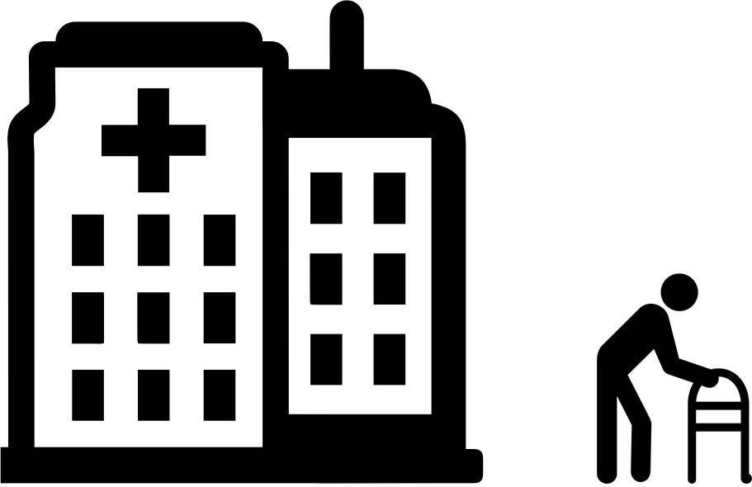
Fear of Deportation Makes Communities Less Healthy
Deportation policy creates a climate of fear and paralysis in communities.
afraid to use parks and exercise outdoors,
People are afraid to drive,
afraid to use public services like clinics,
afraid to get involved in their communities.
Notes:
Immigrants change health-seeking behaviors for themselves and their family members if they fear being stopped by police and potential deportation.
As described in a Massachusetts study, Arizona study, a survey of primary care providers, a survey of patients, a Los Angeles study and HIPs Family Unity, Family Health report:
Immigrants miss medical appointments or less often use public services like health clinics—regular doctor visits, diabetes education, vaccines, prenatal care, HIV education, getting medications, care for communicable diseases like tuberculosis, etc.
They eat less healthy food if afraid to drive. Access to grocery stores with produce and healthy food options often requires travel, which may be a deterrent and adversely impact health.
People are afraid to use parks, exercise outdoors, and participate in their communities.
Image Source: Designs by mohit arora, Marie Ringeard, Delwar Hossain, Luis Prado, corpus delicti, ProSymbols, Anton Gajdosik, H Alberto Gongora for The Noun Project (https://thenounproject.com)

Slide 5
Best Practices & Considerations
Be a strong ally. Speak up! Show up!
Ask yourself, what kind of support do I provide to my patient/client that goes beyond my job duties?
Provide adequate information and resources
Educate others. Provide facts, address assumptions about immigrants, and intervene in situations where misconceptions are being made about an immigrant person.
Identify community resources and partner with organizations that provide legal, education, and other immigrant services and link families to these resources. Consult with other agencies or technical experts about immigrant eligibility

Slide 6
Best Practices & Considerations
Assure immigrant families they are not alone and that you are here to help them.
Ask the family which language they prefer to use and have qualified interpreters if available.
Help reduce fear by making sure internal policies and practices do not create additional obstacles for immigrants.
Provide empathetic and patient-centered care by listening and addressing fears and concerns
Provide training for all staff and volunteers on how to work with immigrants

Slide 7
Sensitive Locations
Schools, community centers, libraries, churches are gathering places and resource hubs for those that may not have access or are fearful to receive those resources elsewhere.
ICE Memo (2011) – Enforcement Actions at or Focused on Sensitive Locations
Memo considers schools, churches, hospitals, a site of a funeral, wedding, or other religious services, and a site of public demonstrations to sensitive spaces for conducting enforcement
This policy is still in place.
Limitations to sensitive locations
Efforts to declare safe spaces for immigrant communities and ensure privacy of personal information.
SB 54 (de Leon) – CA Values Act
SB 244 (Lara) – Privacy Protection Act

Slide 8
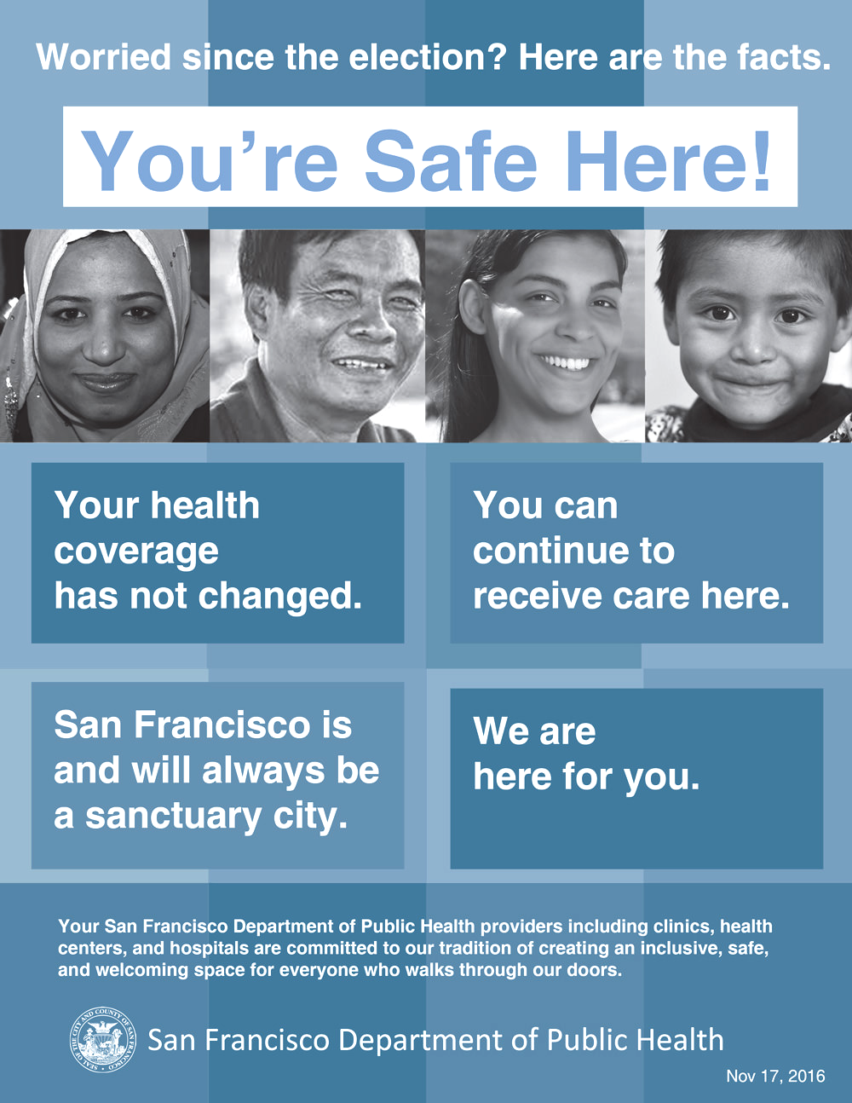
What Centers & Providers Can Do
Publicly state center’s commitment to serving all, regardless of immigration status, and ensuring their protection
Message to families
Make signs & documents in multiple languages, linguistically sensitive, and avoid alienating vocabulary
Learn about religious practices and cultural preferences, but don’t generalize
Notes:
Image Source: We_are_here_for_you.pdf (https://www.sfdph.org/dph/files/election/We_are_here_for_you.pdf)

Slide 9
What Centers & Providers Can Do
Adopt internal policies and procedures that limit law enforcement in the premises
Establish an ICE Protocol and train staff on procedure and policies
What does an ICE agent look like
What to do if immigration agents enter the healthcare facility
Practice a scenario and role-play responses
What does a warrant look like and when is it valid
Where do you keep sensitive documents and patient information
How to report a violation
Prepare Know Your Rights materials and consider providing this information while families wait for their food or when they drop off their child
Build relationship with a legal center or attorney to refer families to, seek advice of policy and procedures, and if ICE does enter a facility
Notes:
Image Source: We_are_here_for_you.pdf (https://www.sfdph.org/dph/files/election/We_are_here_for_you.pdf)

Slide 10
Betzabel Estudillo
Health Policy Manager
bestudillo@caimmigrant.org
California Immigrant Policy Center
Sacramento – Oakland – Los Angeles – San Diego
www.CAimmigrant.org

