Slide 1
Addressing Immigration Concerns at Summer Meal sites in San Diego
Robin mcnulty, san diego hunger coalition
Jennifer seneor, san diego hunger coalition
Notes:
Jenny

Slide 2
The importance
Partners reporting drop in numbers at food programs and that clients are expressing fear.
A very difficult and complex situation—many are not sure what to do.
San Diego has a high population of undocumented individuals: 207,000 individuals
ICE has a presence in San Diego and is arresting individuals for detainment/deportation.
Notes:
Jenny

Slide 3
Notes:
Jenny

Slide 4
Focus group learning & integration into practice
Notes:
Robin

Slide 5
Summer Meals Task Force
The Summer Meals Task Force is facilitated by the San Diego Hunger Coalition and a resource for starting new summer meal sites and improving existing sites. It’s goal is to increase participation in summer meals countywide.
25 partners in the task force
Notes:
Robin

Slide 6
Immigration education for the task force
Provided the taskforce a presentation by an immigration attorney from Legal Aid Society of San Diego so task force members are informed about current policy and it’s impact on those we serve.
1
Presented to the task force on the learnings from the focus groups to disseminate this information to as many people as possible.
2
Notes:
Robin

Slide 7
Recruitment and promotion of sites conducive to the immigrant community
Families expressed that YMCAs and schools were trusted locations.
San Diego Hunger Coalition is working with school districts and the YMCA to add more Summer Meal sites.
Adding a summer meal site at a Youth Center in National City that is sponsored by the Southbay Union School District. Meals will be served indoors at the recreational facility.
New YMCA site located in North County.
Notes:
Robin

Slide 8
Messaging to the community
No registration & no sign-ups +
All children are welcome!
=
Inclusive language to the entire community.
Notes:
Jenny

Slide 9
Notes:
Jenny

Slide 10
Notes:
Jenny

Slide 11
Notes:
Jenny

Slide 12
The draw of summer meal sites
Emphasizing to the Summer Meal Task Force the importance of educational and physical activities.
Working with the City of Oceanside and Oceanside Unified School District to conduct a Summer Meal kick-off:
Educational activities & physical activities including a bounce house, entertainment, DJ, fire department, library bookmobile, etc.
Promotes interest about summer meal sites
Connects partners to summer meal sites so they may be able to offer activities at sites throughout the summer
Notes:
Robin

Slide 13
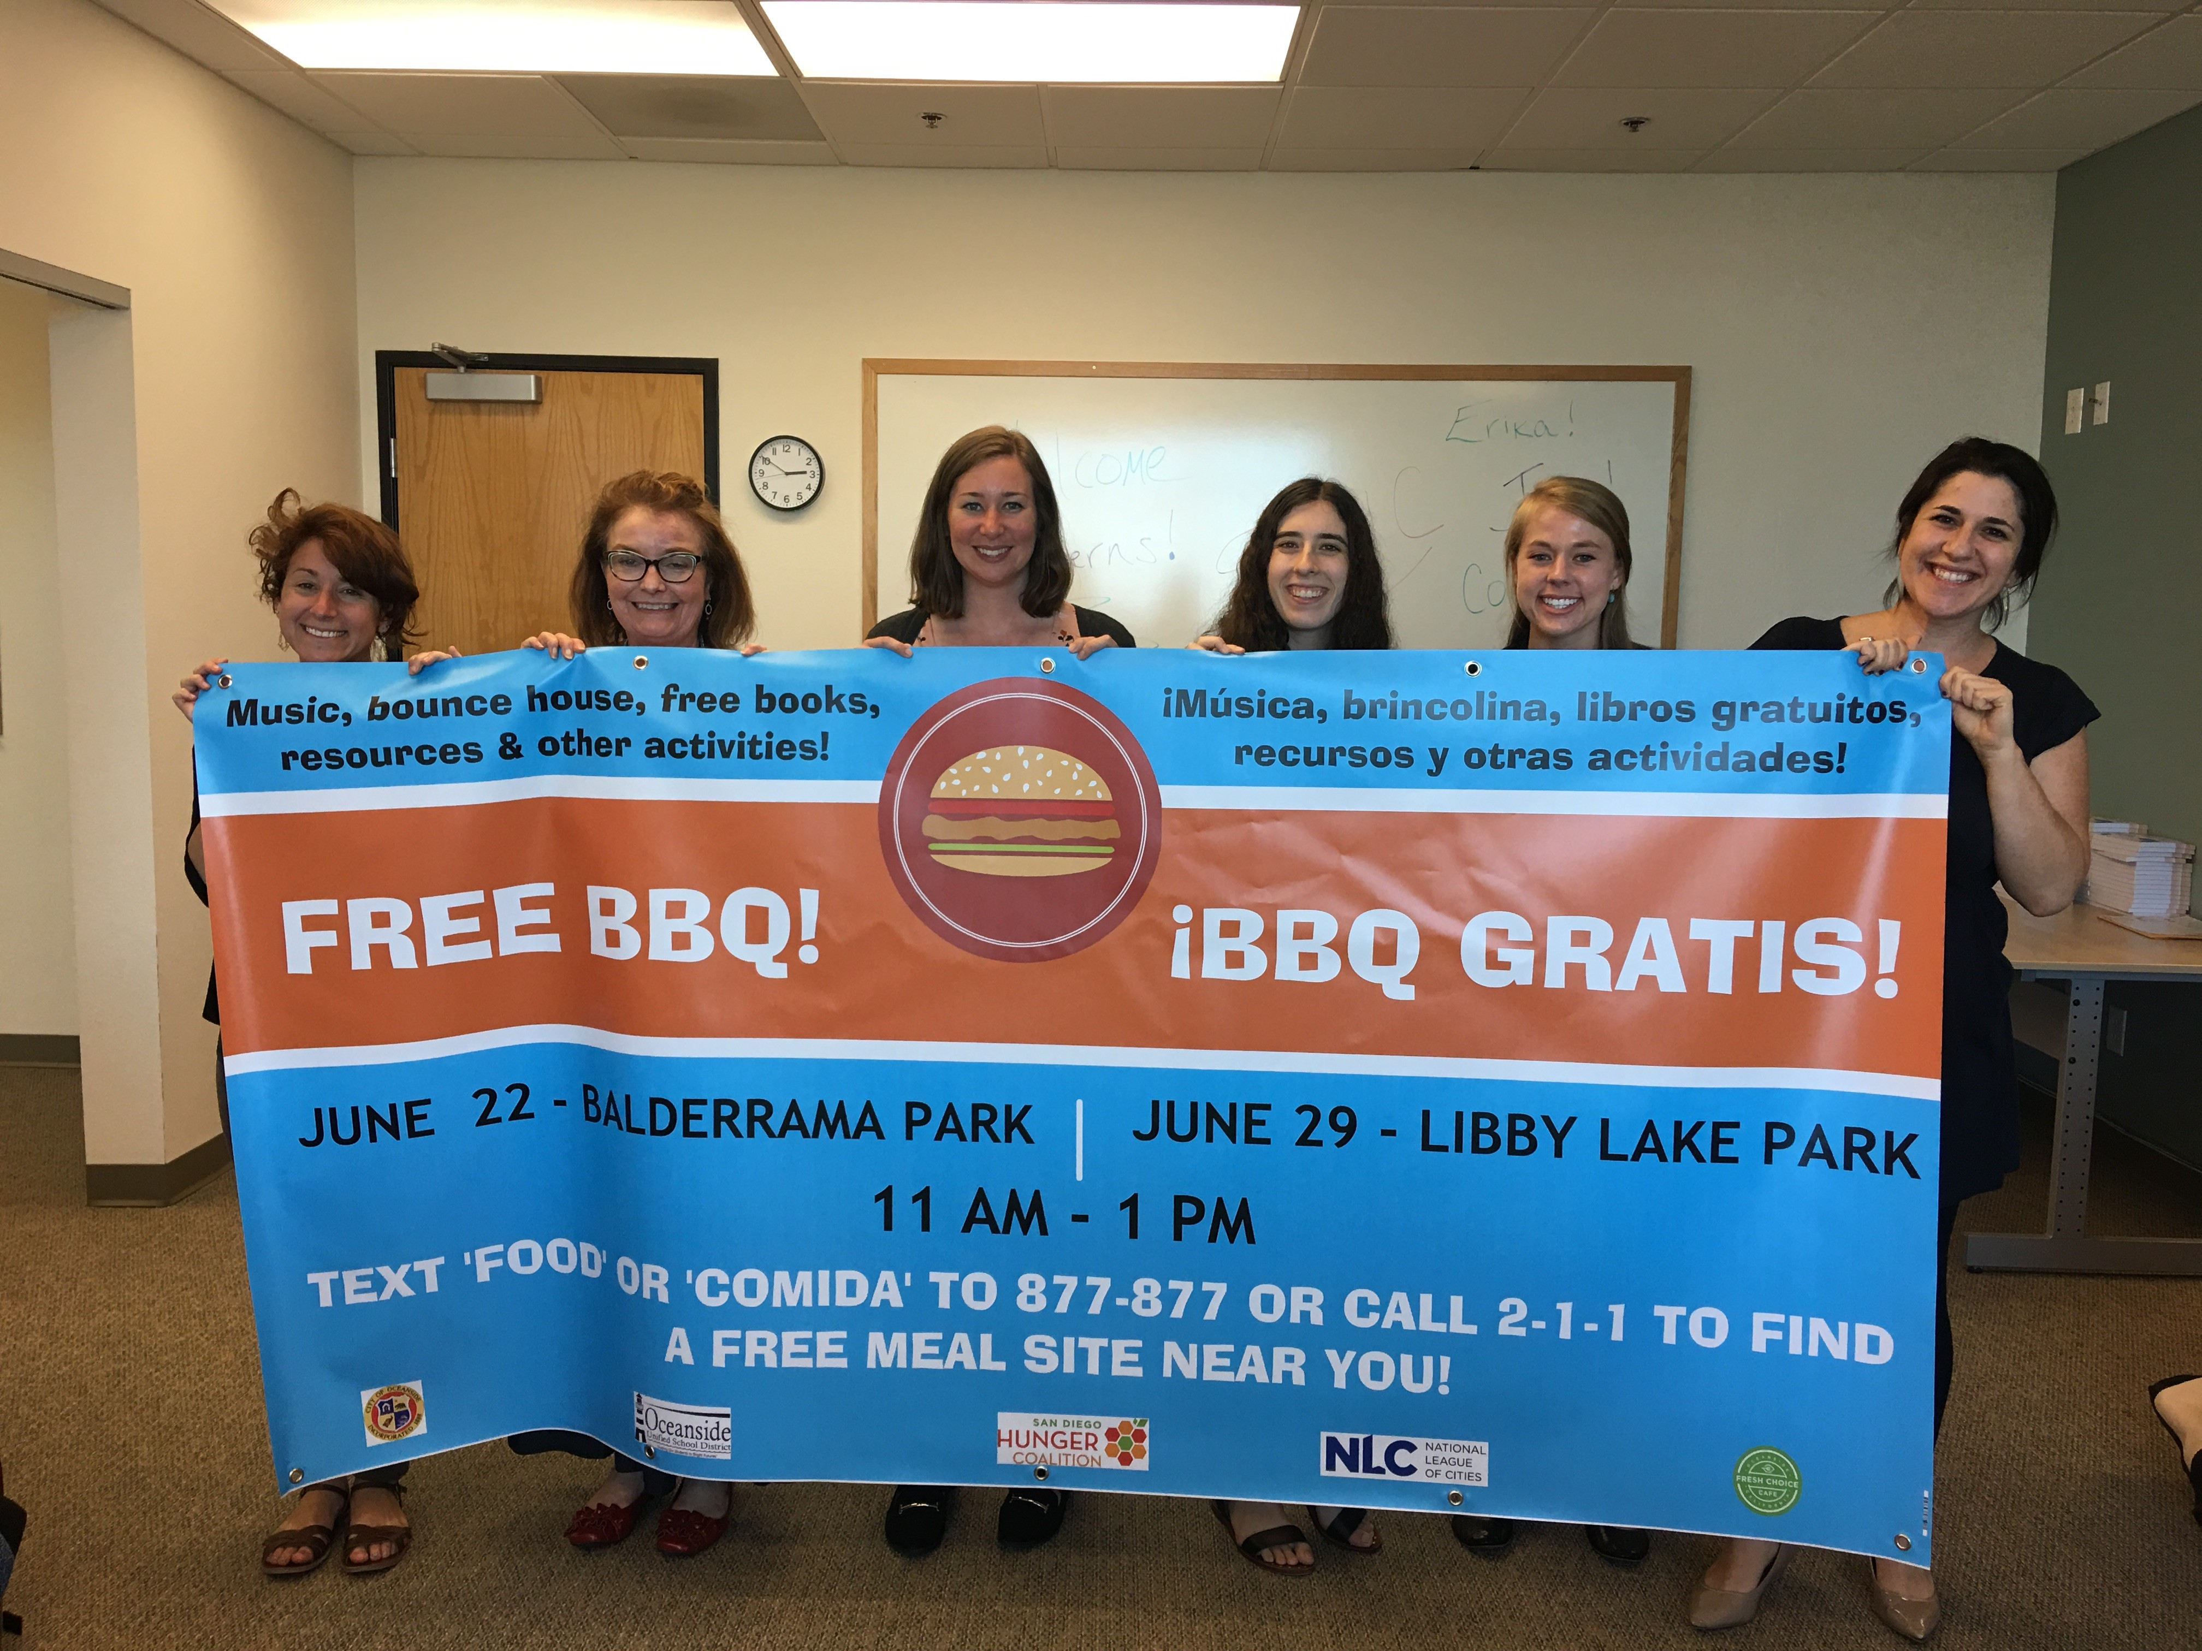
Thank you!
Questions?
Robin McNulty
Director of
School Meals Program
619-501-7917 ex. 104
robin@sdhunger.org
Notes:
Robin and Jenny

